Slide 1
Lecture 10 Algorithm Analysis
Arne Kutzner
Hanyang University / Seoul Korea

Slide 2
Red-Black Trees

Slide 3
General Definition
A red-black tree is a binary search tree + 1 bit per node: an attribute color, which is either red or black.
All leaves are empty (nil) and colored black.
We use a single sentinel, nil[T ], for all the leaves of red-black tree T .
color[nil[T ]] is black.
The root’s parent is also nil[T ].

Slide 4
Red-Black Properties
Every node is either red or black.
The root is black.
Every leaf (nil[T ]) is black.
If a node is red, then both its children are black. (Hence no two reds in a row on a simple path from the root to a leaf.)
For each node, all paths from the node to descendant leaves contain the same number of black nodes.

Slide 5
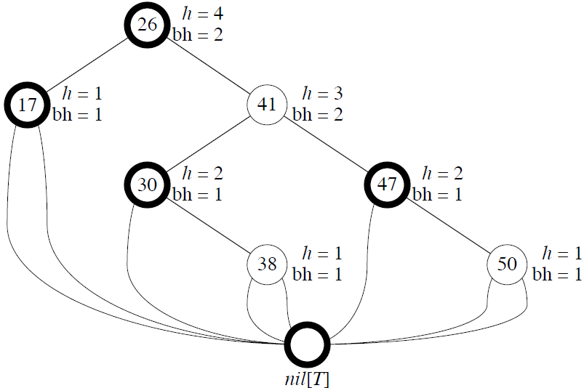
Example

Slide 6
Height of a red-black tree
Height of a node is the number of edges in a longest path to a leaf.
Black-height of a node x: bh(x) is the number of black nodes (including nil[T ]) on the path from x to leaf, not counting x. By property 5, black-height is well defined.

Slide 7
Upper Bound for Height
Lemma 1: Any node with height h has black-height ≥ h/2.
Lemma 2: The subtree rooted at any node x contains ≥ 2^{bh(x)} − 1 internal nodes. Proof: By induction on height of x.

Slide 8
Upper Bound for Height (cont.)
Lemma A red-black tree with n internal nodes has height ≤ 2 lg(n + 1). Proof Let h and b be the height and black-height of the root, respectively. By the above two lemmas, n ≥ 2^{b} − 1 ≥ 2^{h/2} − 1 So we get h ≤ 2 lg(n + 1).

Slide 9
Operations on red-black trees
The non-modifying binary-search-tree operations MINIMUM, MAXIMUM, SUCCESSOR, PREDECESSOR, and SEARCH run in O(height) time. Thus, they take O(lg n) time on red-black trees.
Insertion and deletion are not so easy.
If we insert, what color to make the new node?

Slide 10
Rotations
The basic tree-restructuring operation.
Needed to maintain red-black trees as balanced binary search trees.
Changes the local pointer structure. (Only pointers are changed.)
Won.t upset the binary-search-tree property.
Have both left rotation and right rotation. They are inverses of each other.
A rotation takes a red-black-tree and a node within the tree.

Slide 11
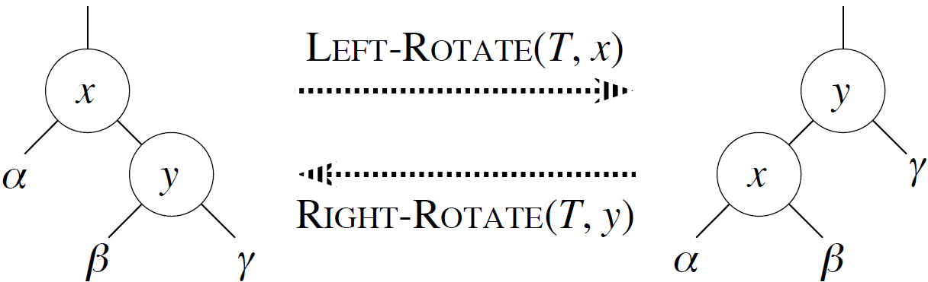
Rotations (cont.)

Slide 12
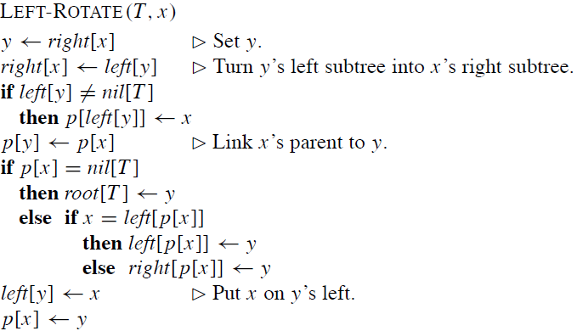
Rotations (Pseudocode)

Slide 13
Rotations Complexity
Time: O(1) for both LEFT-ROTATE and RIGHT-ROTATE, since a constant number of pointers are modified
Notes: Rotation is a very basic operation, also used in AVL trees and splay trees.

Slide 14
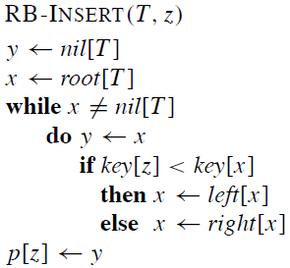
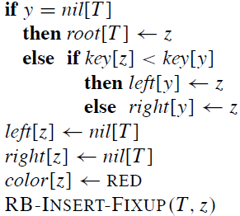
Insertion

Slide 15
Properties of RB-INSERT
RB-INSERT ends by coloring the new node z red.
Then it calls RB-INSERT-FIXUP because we could have violated a red-black property.
Which property might be violated? 1. OK. 2. If z is the root, then there.s a violation. Otherwise, OK. 3. OK. 4. If p[z] is red, there is a violation: both z and p[z] are red. 5. OK.

Slide 16
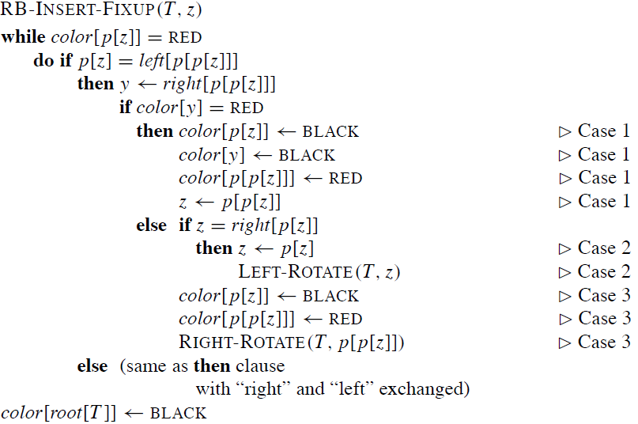
Pseudocode FIXUP

Slide 17
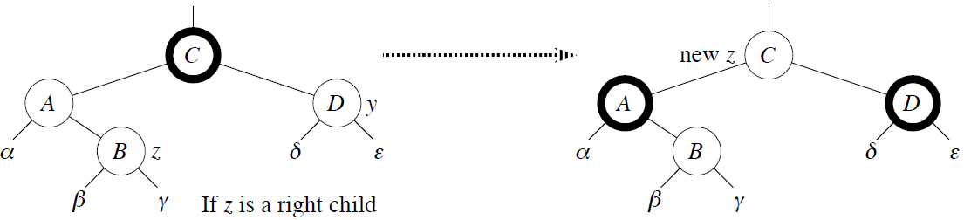
Case 1: y (z’s uncle) is red
p[p[z]] (z.s grandparent) must be black, since z and p[z] are both red and there are no other violations of property 4.
Make p[z] and y black ⇒ now z and p[z] are not both red. But property 5 might now be violated.
Make p[p[z]] red ⇒ restores property 5.
The next iteration has p[p[z]] as the new z (i.e., z moves up 2 levels).
There are 4 variants of case 1

Slide 18


















Case 1:
(Recoloring)
new $z$
C
C
A
D
$$y$$
A
D
$$α$$
B
$$α$$
$$z$$
$$δ$$
$$ε$$
B
$$z$$
$$δ$$
$$ε$$
$$β$$
$$γ$$
$$β$$
$$γ$$
new $z$
C
C
A
D
$$y$$
D
A
$$α$$
B
$$α$$
$$z$$
$$δ$$
$$ε$$
$$ε$$
$$δ$$
$$z$$
B
$$β$$
$$γ$$
$$γ$$
$$β$$

Slide 19
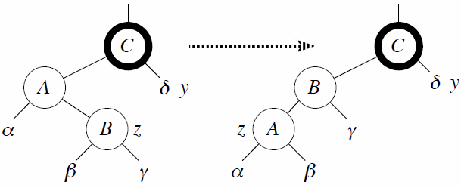
Case 2: y is black, z is a right child
Left rotate around p[z] ⇒ now z is a left child, and both z and p[z] are red.
Takes us immediately to case 3.

Slide 20







Case 2:
(Rotation)
C
C
A
$$y$$
B
$$y$$
$$α$$
B
$$δ$$
$$δ$$
$$z$$
A
$$z$$
$$γ$$
$$β$$
$$γ$$
$$α$$
$$β$$
C
C
A
$$y$$
$$y$$
B
$$α$$
B
$$δ$$
$$δ$$
$$z$$
$$γ$$
$$z$$
A
$$β$$
$$γ$$
$$β$$
$$α$$

Slide 21
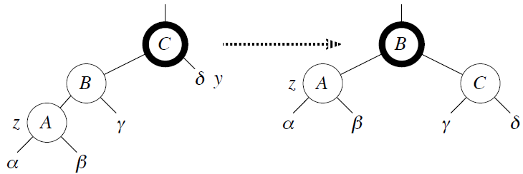
Case 3: y is black, z is a left child
Make p[z] black and p[p[z]] red.
Then right rotate on p[p[z]].
No longer have 2 reds in a row.
p[z] is now black ⇒ no more iterations.

Slide 22








Case 3:
(Rotation + Recoloring)
C
B
B
$$y$$
$$z$$
A
C
A
$$δ$$
$$z$$
$$γ$$
$$α$$
$$β$$
$$γ$$
$$y$$
$$α$$
$$β$$
$$δ$$
C
B
$$y$$
B
C
$$z$$
A
$$δ$$
$$γ$$
$$z$$
A
$$y$$
$$γ$$
$$β$$
$$α$$
$$β$$
$$α$$
$$δ$$

Slide 23
Analysis
O(lg n) time to get through RB-INSERT up to the call of RB-INSERT-FIXUP.
Within RB-INSERT-FIXUP:
Each iteration takes O(1) time.
Each iteration is either the last one or it moves z up 2 levels.
O(lg n) levels ⇒ O(lg n) time.
Also note that there are at most 2 rotations overall.
Thus, insertion into a red-black tree takes O(lg n) time.

Slide 24
Correctness
Loop invariant: At the start of each iteration of the while loop,
z is red.
There is at most one red-black violation:
Property 2: z is a red root, or
Property 4: z and p[z] are both red.
Initialization: loop invariant holds initially.
Termination: The loop terminates because p[z] is black. Hence, property 4 is OK. Only property 2 might be violated, and the last line fixes it.
Maintenance: We drop out when z is the root (since then p[z] is the sentinel nil[T ], which is black). When we start the loop body, the only violation is of property 4.

Slide 25
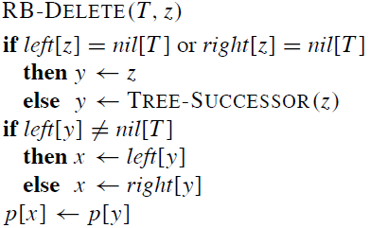
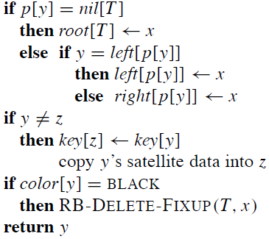
Deletion

Slide 26
Deletion - Remarks
y is the node that was actually spliced out.
x is
either y’s sole non-sentinel child before y was spliced out,
or the sentinel, if y had no children.
In both cases, p[x] is now the node that was previously y’s parent.

Slide 27
3 possible Problems
If y is black, we could have violations of red-black properties:
OK.
If y is the root and x is red, then the root has become red.
OK.
Violation if p[y] and x are both red.
Any path containing y now has 1 fewer black node.

Slide 28
How to Fix ? Idea:
Add 1 to count of black nodes on paths containing x.
Now property 5 is OK, but property 1 is not
x is either doubly black (if color[x] = BLACK) or red & black (if color[x] = RED)
The attribute color[x] is still either RED or BLACK. No new values for color attribute.

Slide 29
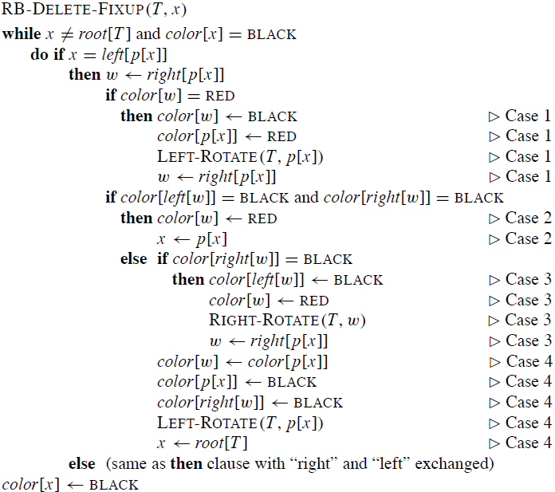
Pseudocode for Fixup

Slide 30
RB-DELETE-FIXUP Remarks
Idea: Move the extra black up the tree until
x points to a red & black node ⇒ turn it into a black node,
x points to the root ⇒ just remove the extra black, or
Within the while loop:
x always points to a nonroot doubly black node.
w is x’s sibling.
w cannot be nil[T ], since that would violate property 5 at p[x].

Slide 31
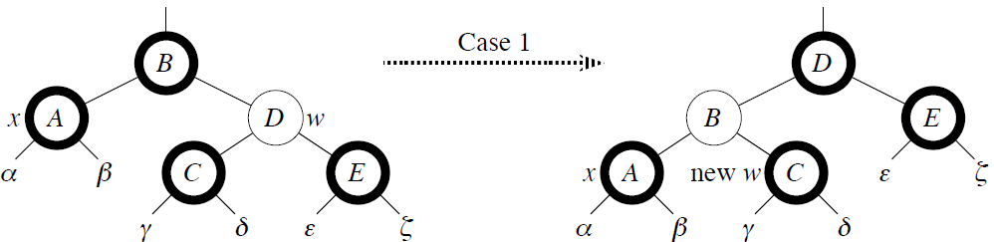
Case 1: w is red
w must have black children.
Make w black and p[x] red.
Then left rotate on p[x].
New sibling of x was a child of w before rotation ⇒ must be black.
Go immediately to case 2, 3, or 4.

Slide 32
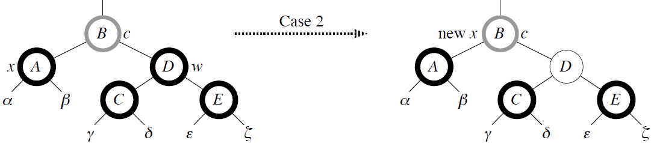
Case 2: w is black and both of w’s children are black
Take 1 black off x (⇒singly black) and off w (⇒red).
Move that black to p[x].
Do the next iteration with p[x] as the new x.
If entered this case from case 1, then p[x] was red ⇒ new x is red & black ⇒ color attribute of new x is RED ⇒ loop terminates. Then new x is made black in the last line.

Slide 33
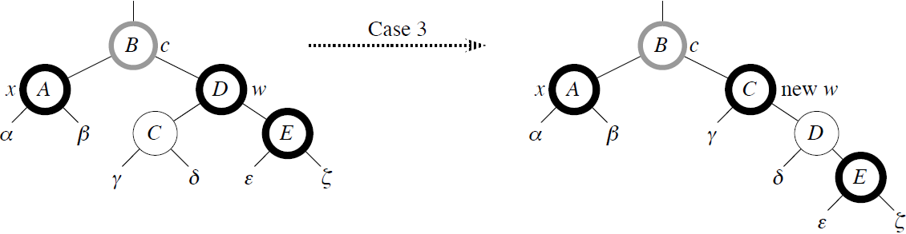
Case 3: w is black, w’s left child is red, and w’s right child is black
Make w red and w’s left child black.
Then right rotate on w.
New sibling w of x is black with a red right child ⇒ case 4.

Slide 34
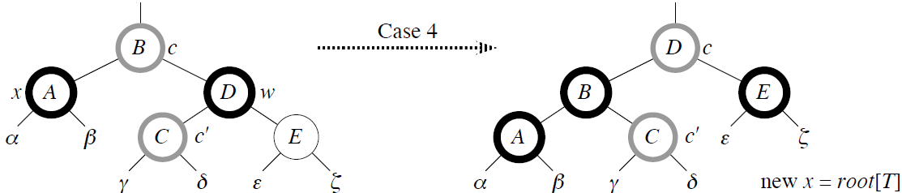
Case 4: w is black, w’s left child is black, and w’s right child is red
Make w be p[x]’s color (c).
Make p[x] black and w’s right child black.
Then left rotate on p[x].
Remove the extra black on x (⇒ x is now singly black) without violating any red-black properties.
All done. Setting x to root causes the loop to terminate.

Slide 35
Analysis - Deletion
O(lg n) time to get through RB-DELETE up to the call of RB-DELETE-FIXUP
Within RB-DELETE-FIXUP:
Case 2 is the only case in which more iterations occur
x moves up 1 level
Hence, O(lg n) iterations
Each of cases 1, 3, and 4 has 1 rotation⇒≤3 rotations in all
Hence, O(lg n) time

Slide 36
23
Example tree for exercising
during class
7
30
17
25
35
3
NIL
NIL
NIL
11
20
NIL
27
5
NIL
NIL
NIL
NIL
NIL
NIL
9
13
NIL
NIL
NIL
NIL

